Slide 1
Final Project Weather App
A modern, reactive weather and air quality monitoring application built natively for Android.
Presented by: Liran Cordova, Or Rodrigez, Or Zuka

Slide 2






Project Summary & Purpose
Core Summary
Primary Purpose
Target Audience
An Android application providing real-time weather data, detailed 5-day forecasts, and air quality (pollution) information powered by the OpenWeatherMap API.
Offer users a clean interface to monitor their local environment and manage favorite global locations for quick access.
Designed for general mobile users, frequent travelers, and health-conscious individuals who need reliable monitoring of varying air quality levels.

Slide 3



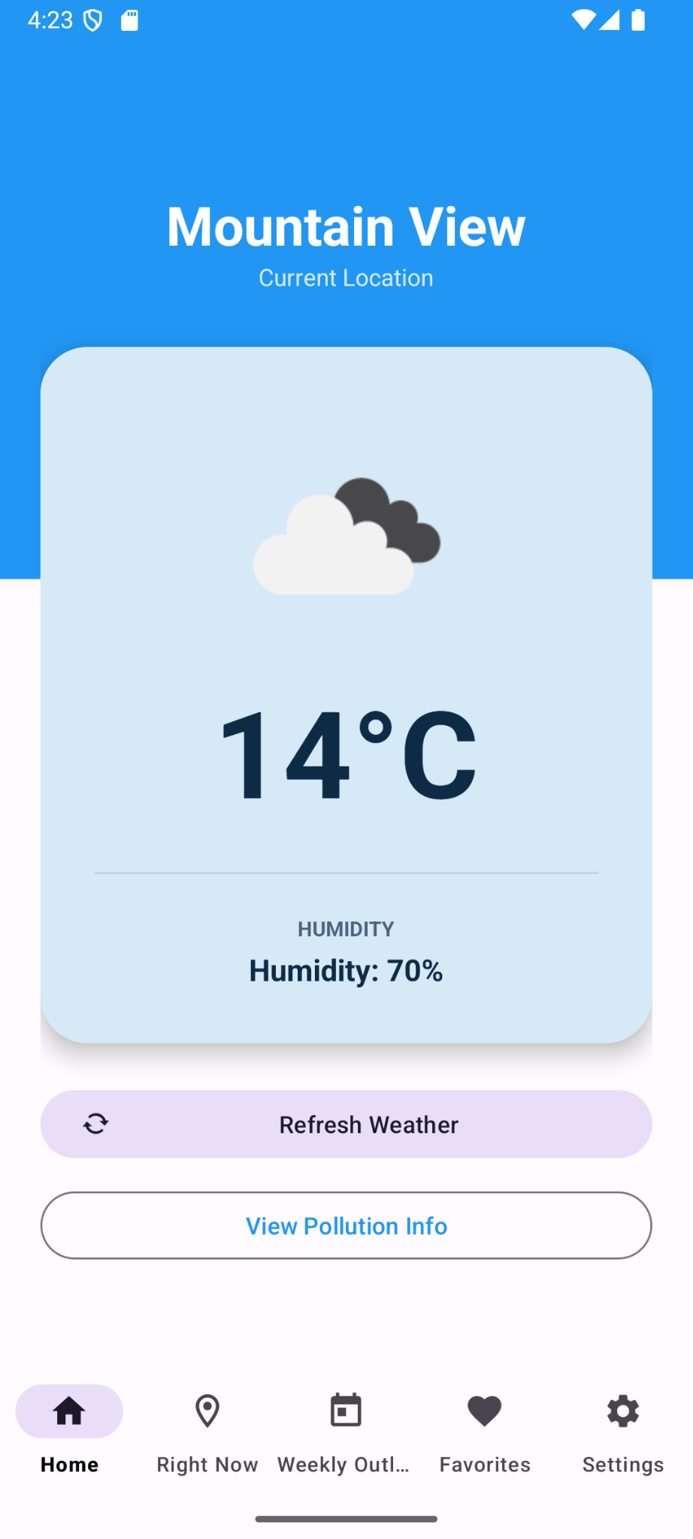
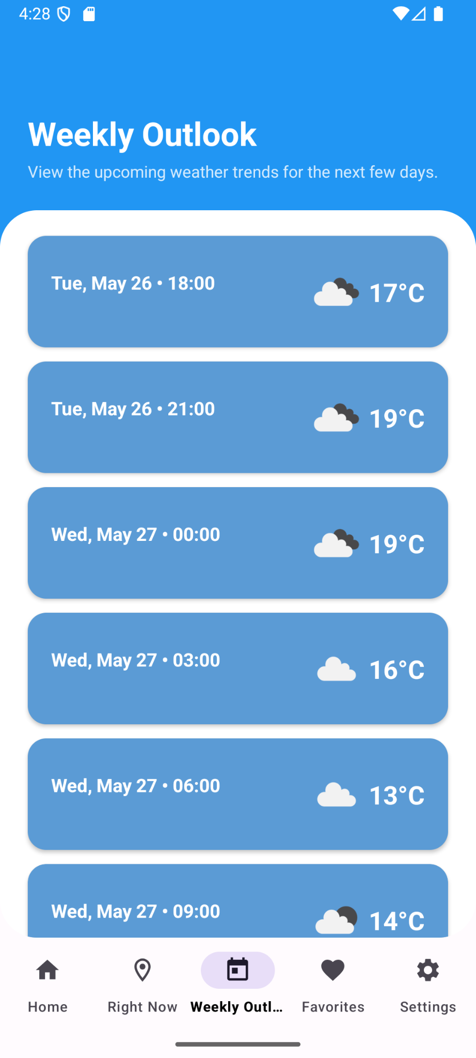
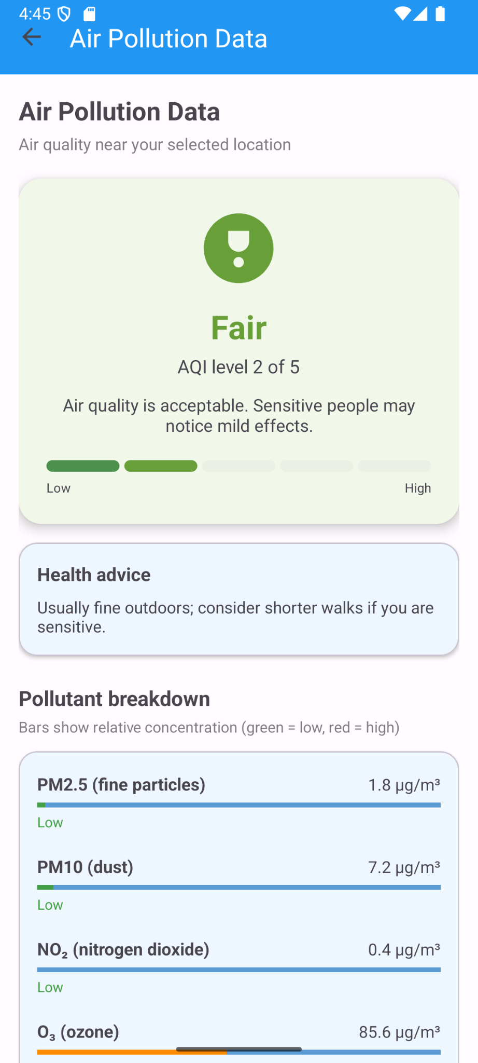
App Screen Flow (1/2)
Home Fragment
Forecast Fragment
Pollution Fragment
Displays current temperature, core weather conditions, and main quick actions.
Shows a detailed, scrollable list of the next 5 days predicted weather.
Detailed breakdown of the AQI (Air Quality Index) and specific pollutant metrics.

Slide 4
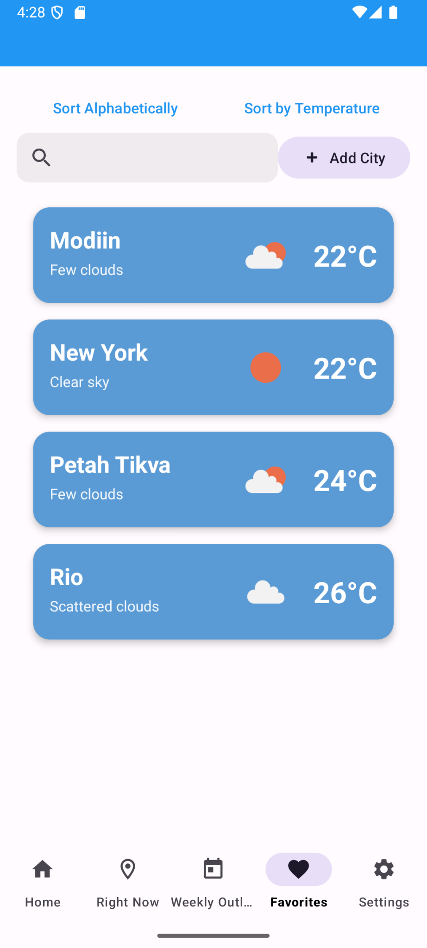
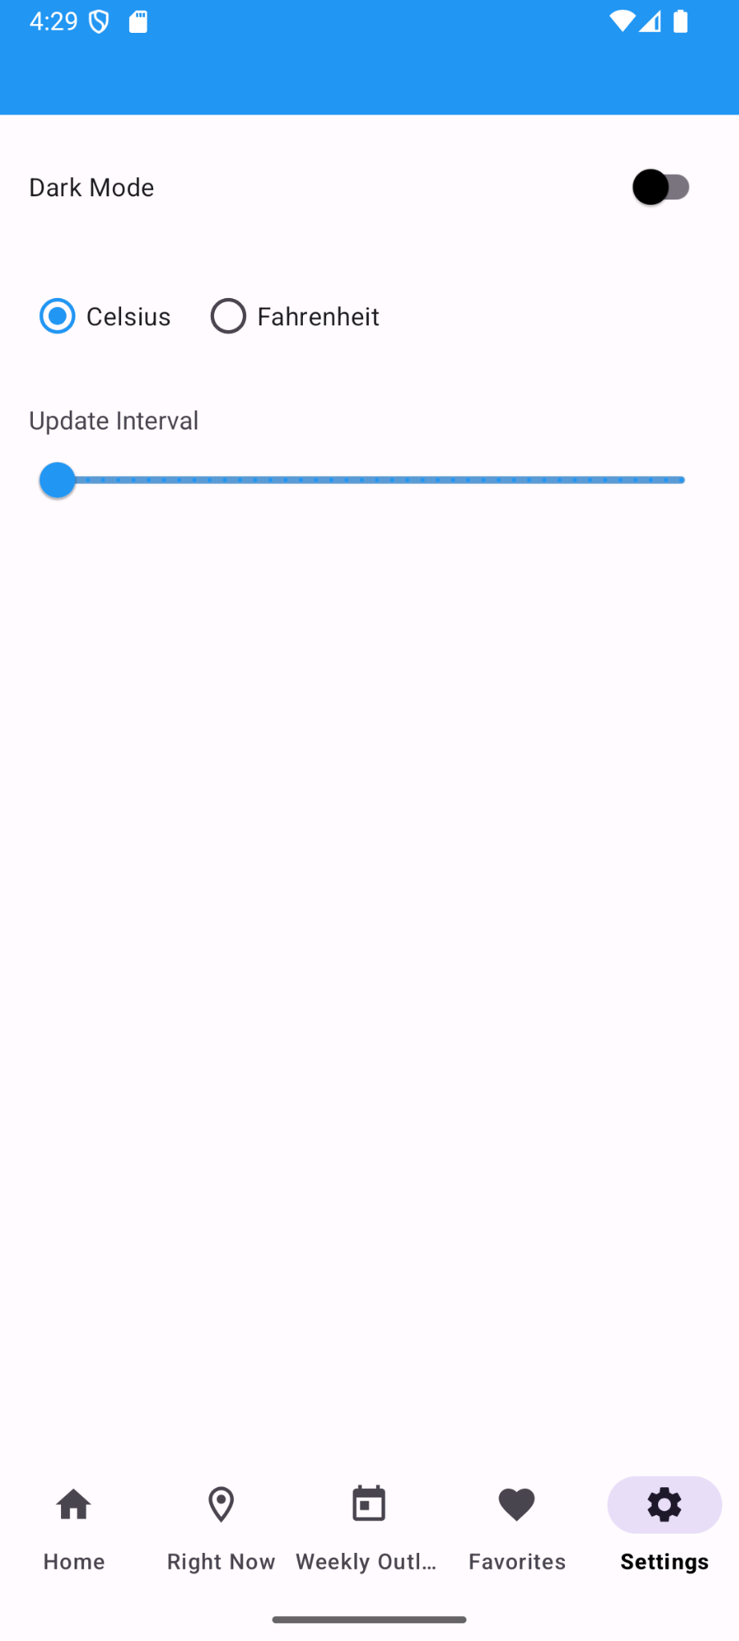
App Screen Flow (2/2)
Forecast Fragment
Favorites Fragment
Settings Fragment
A dynamic weather forecast list
A list of saved cities stored in the local Room database for quick access.
Options for unit toggling (Celsius/Fahrenheit) and notification preferences.

Slide 5
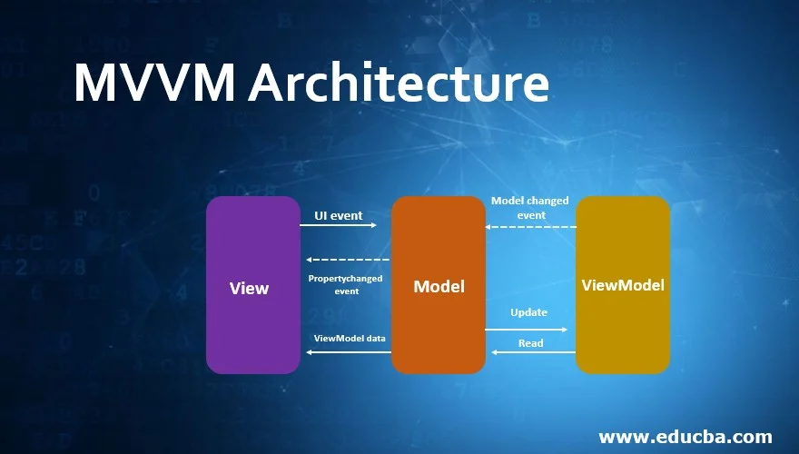

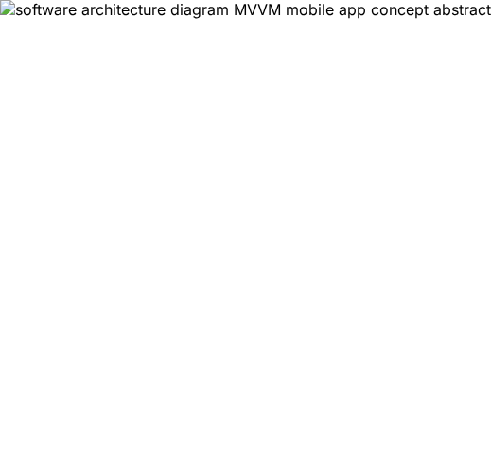
Project Architecture
MVVM Pattern Utilizes Model-View-ViewModel to separate UI components from business logic and data state.
Dependency Injection Implements Dagger-Hilt for modular, scalable, and easily testable code architecture.
Remote Data Flow Retrofit handles fetching structured JSON data from the OpenWeatherMap REST API.
Local Data Flow Room Persistence Library securely caches data for offline access and manages Favorites.

Slide 6




External Libraries
Networking (Retrofit & Gson) Handles asynchronous API communication and JSON serialization robustly.
Database (Room) Provides an abstraction layer over SQLite for smooth local data storage.
Injection (Dagger-Hilt) Manages lifecycle-aware dependency injection automatically across the app.
Image Loading (Glide) Efficiently fetches and caches high-quality weather icons from the web.
Background Tasks (WorkManager) Ensures scheduled weather updates execute reliably even if the app is closed.

